Slide 1
Introduction to Data Structure

Slide 2
What is Data Structure?
A data structure is a particular way of storing and organizing data in a computer so that it can be used efficiently.
They provide a means to manage large amounts of data efficiently, such as large databases.
Data are simply values or set of values and Database is organized collection of data.

Slide 3
What is Data Structure? (…contd)
A data structure is a logical and mathematical model of a particular organization of data.
The choice of particular data structure depends upon following consideration:
1.It must be able to represent the inherent relationship of data in the real world.
2.It must be simple enough so that it can be processed efficiently as and when necessary.

Slide 4
THE STUDY OF DATA STRUCTURE INCLUDE:
Logical description of data structure
Implementation of data structure
Quantitative analysis of data structure, this include amount of memory, processing time

Slide 5
Classification of Data Structure
Data Structures
Primitive Data Structures
Non-Primitive Data Structures
Integer
Real
Character
Boolean
Linear Data Structures
Non -Linear Data Structures
Arrays
Trees
Stacks
Graphs
Linked List
Queues

Slide 6
Classification (contd..)
A data structure can be broadly classified into
Primitive data structure
Non-primitive data structure
Primitive data structure :-The data structures, that are directly operated upon by machine level instructions i.e. the fundamental data types such as int, float in case of ‘c’ are known as primitive data structures.
Non- Primitive data structure :-These are more complex data structures. These data structures are derived from the primitive data structures.

Slide 7
Classification (contd..)
Non-Primitive Data Structures can be further divided into two categories:
Linear Data Structures
Non-Linear Data Structures.
Linear Data Structures:-In linear data structures, data elements are organized sequentially and therefore they
are easy to implement in the computer’s memory. E.g. Arrays.
Non-Linear Data Structures:-In nonlinear data structures, a data element can be attached to several other data elements to represent specific relationships that exist among them. E.g. Graphs

Slide 8
Array & Linked List
[0]
[1]
[2]
Array
A
B
C
node
linked
Linked list
A
B
C
Linked lists are unbounded
(maximum number of items limited only by memory)

Slide 9
Stack
Stack
New nodes can be added and removed only at the top
Similar to a pile of dishes
Last-in, first-out (LIFO)
push
Adds a new node to the top of the stack
pop
Removes a node from the top

Slide 10
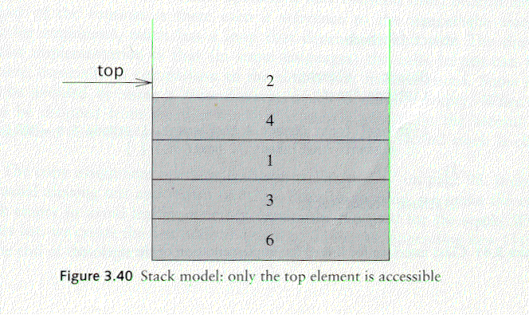
Stack
A stack is a list in which insertion and deletion take place at the same end
This end is called top
The other end is called bottom.

Slide 11
Queue
Queue
Similar to a supermarket checkout line
First-in, first-out (FIFO)
Nodes are removed only from the head
Nodes are inserted only at the tail
Insert and remove operations
Enqueue (insert) and dequeue (remove)

Slide 12
The Queue Operations
A queue is like a line of people waiting for a bank teller. The queue has a front and a rear.
$ $
Walking out
Rear(insertion)
Front(Removal)
Notes:
When you think of a computer science queue, you can imagine a line of people waiting for a teller in a bank. The line has a front (the next person to be served) and a rear (the last person to arrive.

Slide 13
Tree
A tree T is a finite non empty set of elements. One of these elements is called the root, and the remaining elements, if any, are portioned into trees, which are called the sub trees of T.

Slide 14
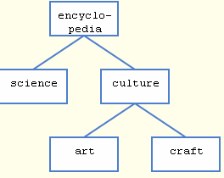
Tree (example)
node
edge

Slide 15
Graph
A graph is defined as:
“Graph G is a ordered set (V,E), where V(G) represent the set of elements, called vertices, and E(G) represents the edges between these vertices.”
Graphs can be
Undirected
Directed

Slide 16
Graph
Figure shows a sample graph
V(G)={v1,v2,v3,v4,v5}
E(G)={e1,e2,e3,e4,e5}
e2
v5
v1
e3
v4
e5
e1
v2
v3
e4
Fig . (a) Undirected Graph

Slide 17
Graph
e2
v5
v1
e3
v4
e5
e1
v2
v3
e4
Fig. (b) Directed Graph
In directed graph, an edge is represented by an ordered pair (u,v) (i.e.=(u,v)), that can be traversed only from u toward v.

Slide 18
Data Structure Operations
Five major operations are associated with all data structures.
Creation:- Initialization of the beginning.
Insertion: - Insertion means adding new details or new node into the data structure.
Deletion: - Deletion means removing a node from the data structure.
Traversal: - Traversing means accessing each node exactly once so that the nodes of a data structure can be processed. Traversing is also called as visiting.
Searching: - Searching means finding the location of node for a given key value.

Slide 19
Data Structure Operations(contd..)
Apart from the four operations mentioned above, there are two more operations occasionally performed on data structures. They are:
(a) Sorting: -Sorting means arranging the data in a particular order.
(b) Merging: - Merging means joining two lists.

Slide 20
A first look on ADTs
Solving a problem involves processing data, and an important part of the solution is the efficient organization of the data
In order to do that, we need to identify:
The collection of data items
Basic operation that must be performed on them

Slide 21
Abstract Data Type (ADT)
An ADT is a mathematical model of a data structure that specifies the type of data stored, the operations supported on them, and the types of parameters of the operations.
An ADT specifies what each operation does, but not how it does it

Slide 22
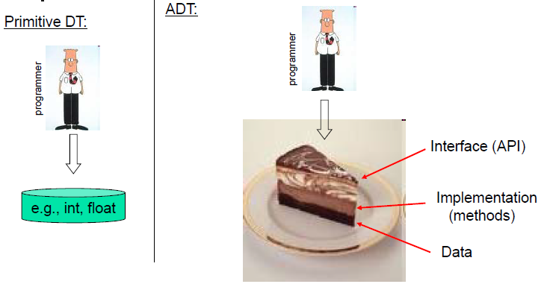
Primitive Data Type vs ADT

Slide 23
Some ADT’s
Some user defined ADT’s are
Stacks
Queues

Slide 24
Stack ADT
We define a stack as an ADT as shown below:

Slide 25
Queue ADT
We define a queue as an ADT as shown below:

